Slide 1

EMPLOYEE LOGIN FOR CIEL HR
Employee Login ID and Password
Step 1 - log on to our website www.fhpl.net
Step 2 – Click on the “Logins” select “ Employee”
Step 3 - Key the following Details:
Corporate ID (Mandatory Field) : 12977
Username: : EMP ID
Password: : EMP ID

Slide 2
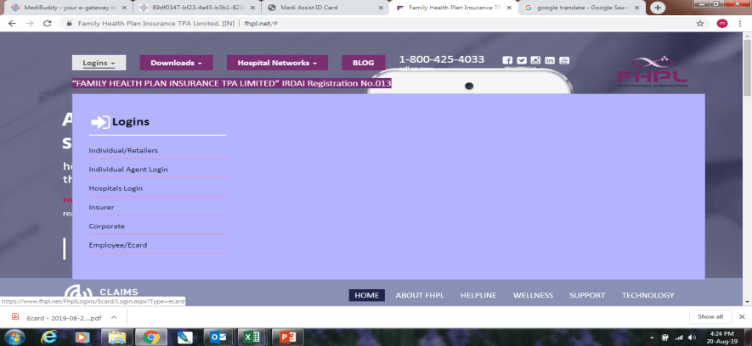
Step 2 – Click on the “Logins” select “ Employee”

Slide 3
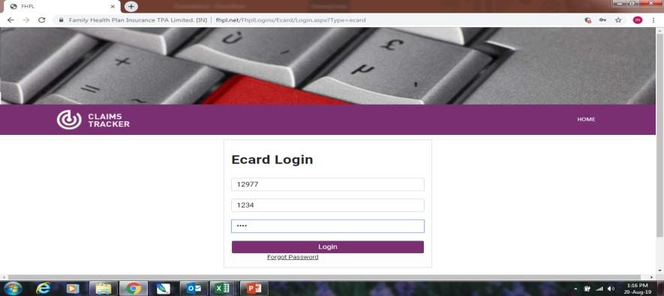
Corporate ID (Mandatory Field) : 12977 Username: : EMP ID Password: : EMP ID

Slide 4
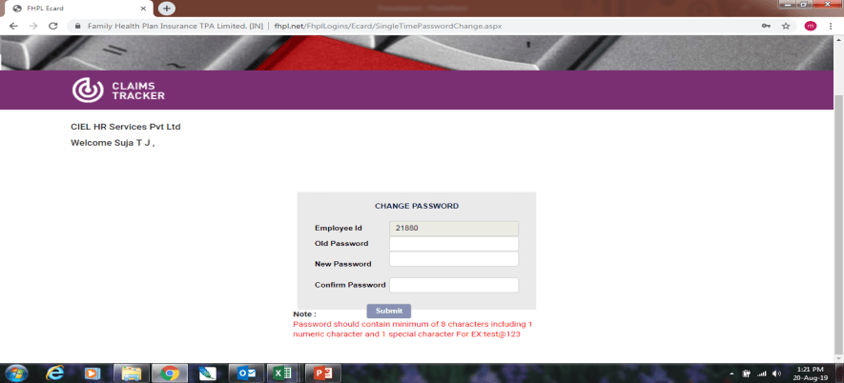
Password should contain minimum of 8 characters including 1 numeric character and 1 special character For EX:test@123

Slide 5
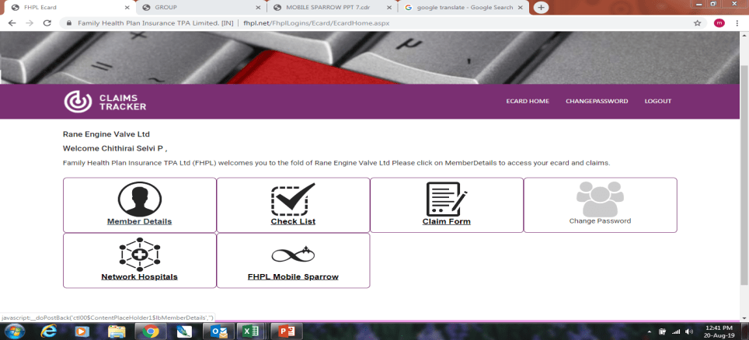
Click Member list

Slide 6
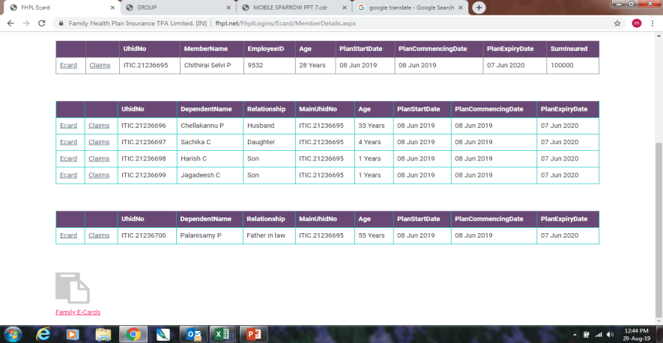
Click Here You can download your Family E cards
Click Here

Slide 7
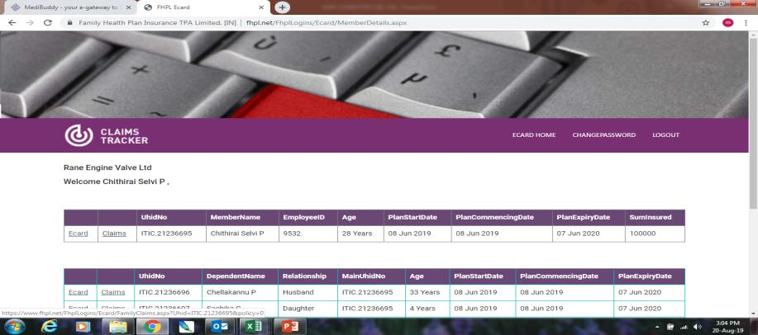
Click Here you Can able to view your claim details

Slide 8
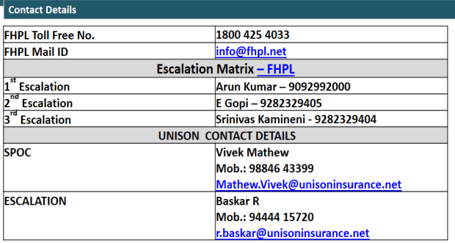
Please Feel Free contact us

Slide 9

Thank you

